Slide 1
Axios

Slide 2
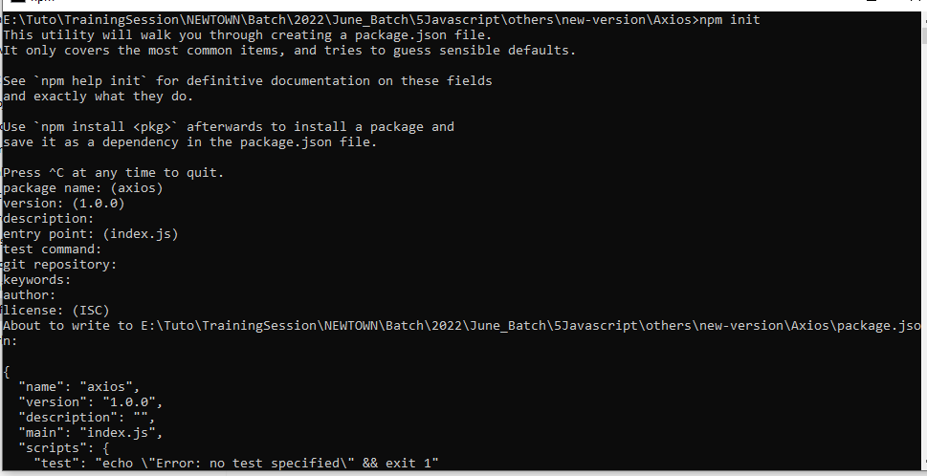
Setup the package.json using npm init

Slide 3
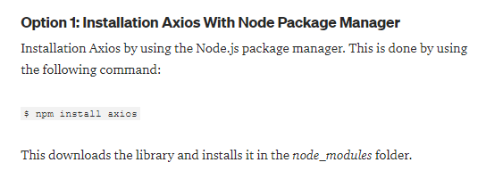
Install the package

